Slide 1

A Distributional Perspective of Reinforcement Learning Authors : Marc G. Bellemare, Will Dabney, Rémi Munos
Presented By: Saranya Krishnasami

Slide 2
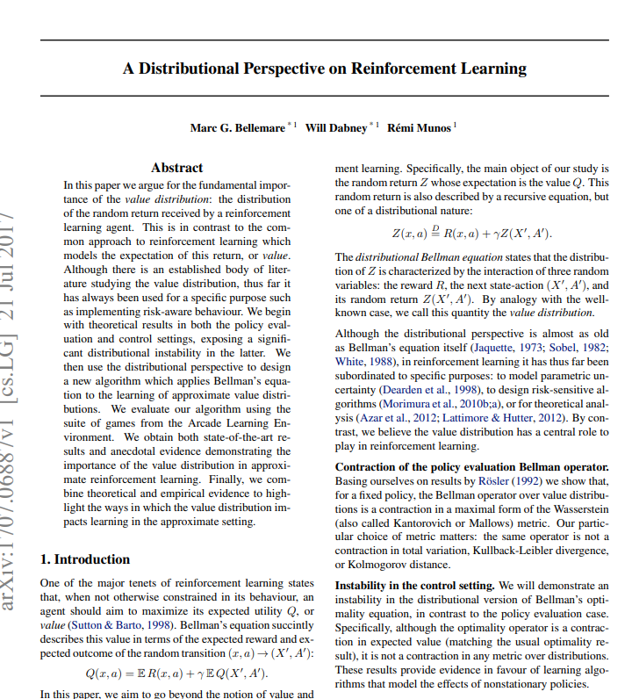


Slide 3
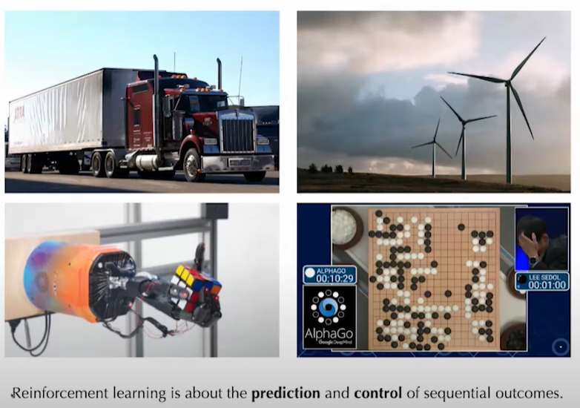
Reinforcement Learning

Slide 4
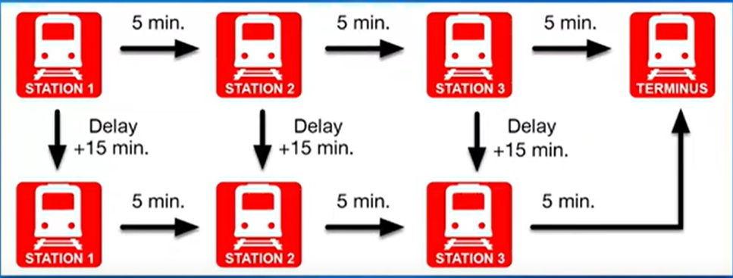
Traditional RL – Example 1
Breaks down once a week ( 1 out of 5 days )
Estimated Average travel time
(3 X 5) + 15 / 5 = 18 minutes

Slide 5
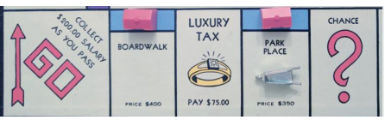
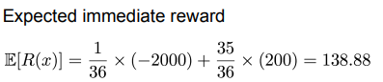
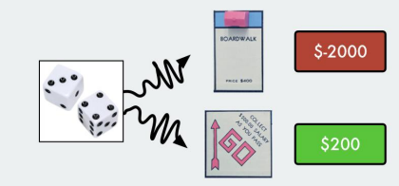
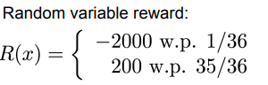
Traditional RL – Example 2
Random immediate reward

Slide 6
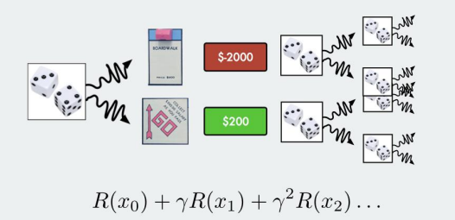
Problem statement:
Random Returns are often Complex and Multimodal
Modelling the expected return hides this intrinsic randomness:
R(x) = 139 in Monopoly
or
R(x) = 18 in Train problem < never actually achieved ! >

Slide 7
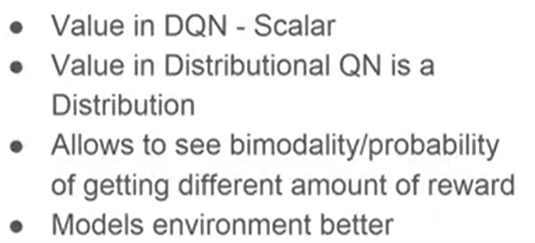
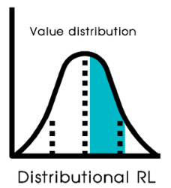
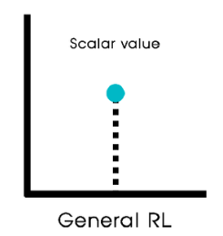
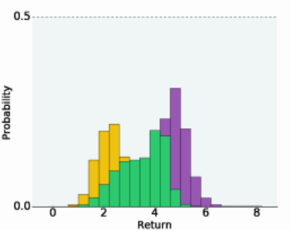
Traditional RL
Distributional RL
Image source : source

Slide 8
Agenda | Distributional RL
Preamble
C51 Algorithm
Evaluation and Results
Summary

Slide 9
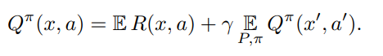
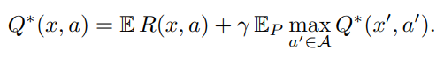
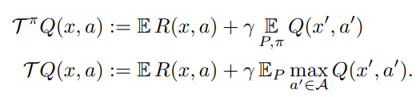
Distributional RL
Bellman Equations
Preamble
C51 Algorithm
Evaluation and Results
Summary
Bellman operator T π and optimality operator T
Notes:
The Bellman operator, denoted as Tπ, is a key concept used to define the action-value function, commonly denoted as Qπ. The Bellman operator represents the action-value function's update rule under a given policy π.
The uniqueness of the fixed-point of the Bellman operator implies that if we find a Q such that T πQ = Q, then Q = Qπ .

Slide 10
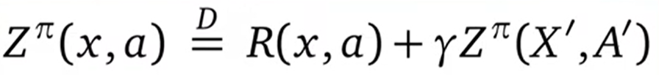
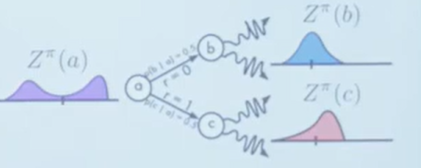
Distributional RL
Bellman Equations
Preamble
C51 Algorithm
Evaluation and Results
Summary
Distributional Bellman equation

Slide 11
Distributional RL
Preamble
Distributional Bellman Operators
C51 Algorithm
Evaluation and Results
Summary
What are the authors trying to do ?
*Z, R, X (State S is denoted as X) , A – All capital letter denote they are Random Variables

Slide 12
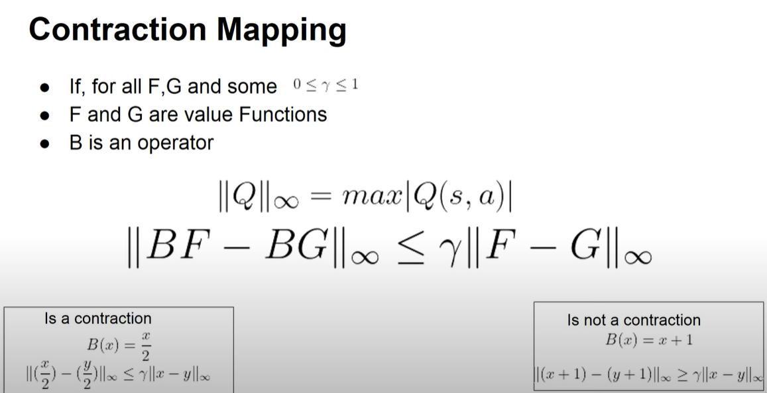
Distributional RL
Preamble
Distributional Bellman Operators
C51 Algorithm
Evaluation and Results
Summary
Notes:
In reinforcement learning (RL), a contraction mapping refers to a property of certain operators applied to value functions. Specifically, it pertains to operators that bring a value function closer to the optimal value function with each iteration.

Slide 13
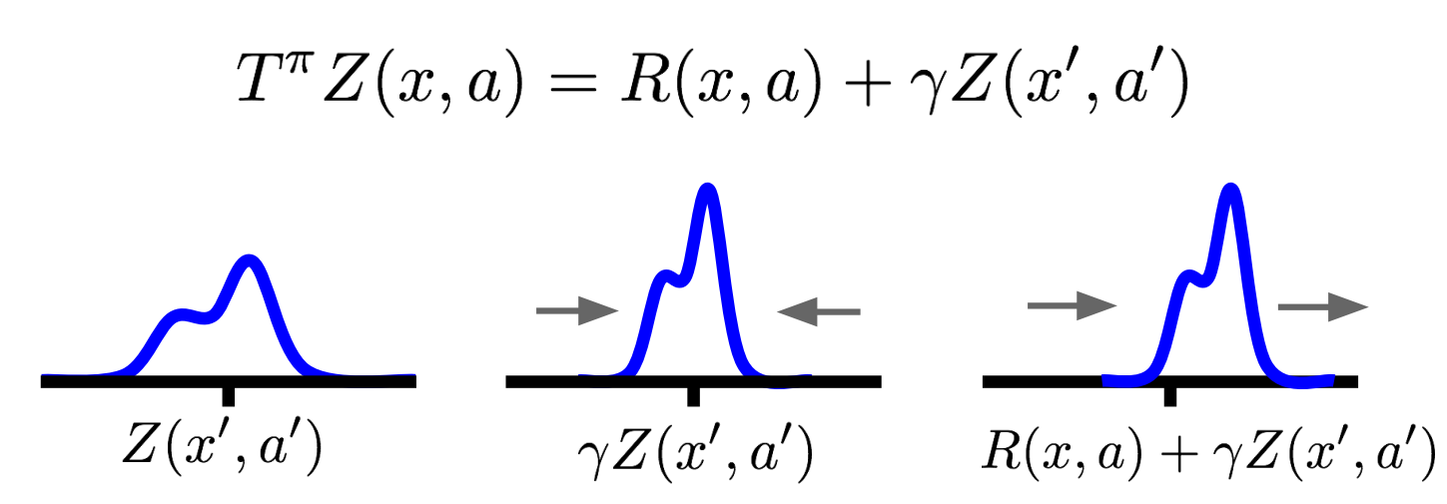
Distributional RL
Preamble
Distributional Bellman Operators
C51 Algorithm
Evaluation and Results
Summary
Distributional Bellman operator (T π)

Slide 14
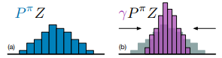
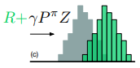
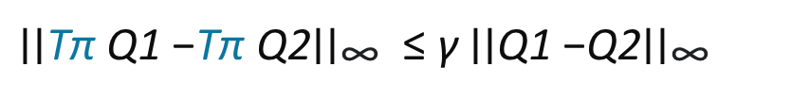
Distributional RL
Preamble
Distributional Bellman Operators
C51 Algorithm
Evaluation and Results
Summary
Expected RL
Distributed RL
${\text{∣∣}\text{T}\text{π} \text{Q}\text{1 }\text{−}\text{T}\text{π} \text{Q}\text{2}\text{∣∣}}_{\text{∞}}$ ≤ ${\text{γ} \text{∣∣}\text{Q}\text{1 }\text{−}\text{Q}\text{2}\text{∣∣}}_{\text{∞}}$
?

Slide 15
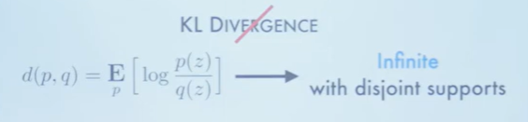
Distributional RL
What Probability Distance ?
KL Divergence
Wasserstein Metric
Preamble
Distributional Bellman Operators
C51 Algorithm
Evaluation and Results
Summary

Slide 16
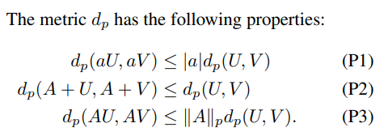
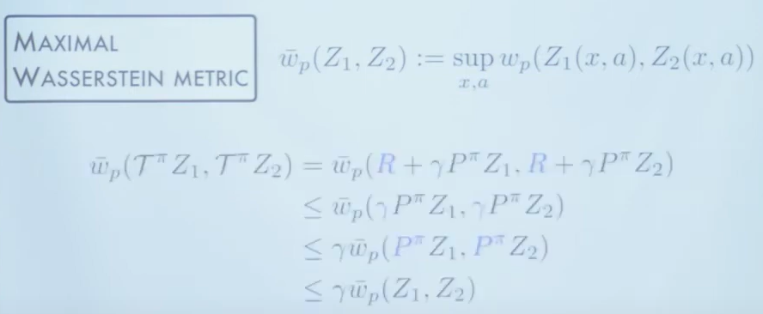
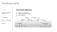
Distributional RL
Wasserstein Metric(dp)
Preamble
Distributional Bellman Operators
C51 Algorithm
Evaluation and Results
Summary
----- P2
----- P1
----- P3
refer
Notes:
The contraction property of the distributional Bellman operator refers to a key theoretical result in distributional reinforcement learning. It states that when the Bellman operator is applied to action-value distributions (i.e., distributions representing the expected future rewards for taking a particular action in a given state), the resulting action-value distribution becomes closer to the true action-value distribution for the optimal policy. This closeness is typically measured in terms of some metric, often the Wasserstein metric.
for a fixed policy, the Bellman operator over value distributions is a contraction in a maximal (Supremum) form of the Wasserstein

Slide 17
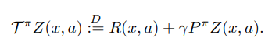
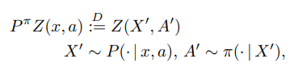
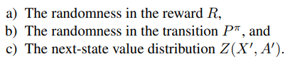
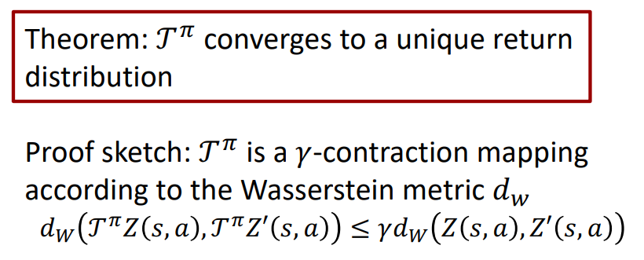
Distributional RL
Policy Evaluation Case
where,
Preamble
Distributional Bellman Operators
C51 Algorithm
Evaluation and Results
Summary

Slide 18
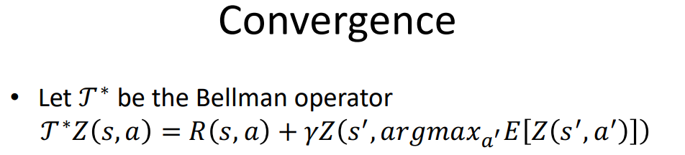
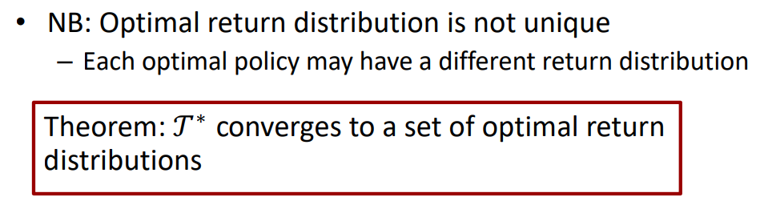
Distributional RL
Policy Control Case
Preamble
Distributional Bellman Operators
C51 Algorithm
Evaluation and Results
Summary
Pointer : Cannot exhibit that T∗ is contraction mapping

Slide 19
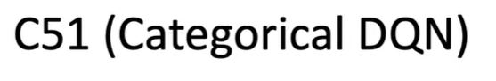
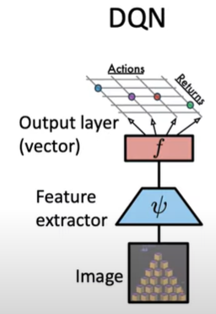
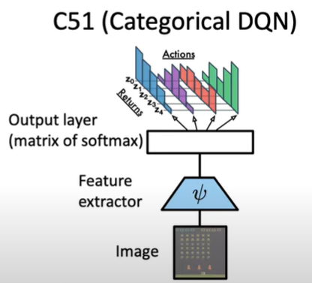
Distributional RL
Preamble
Distributional Bellman Operators
C51 Algorithm
Evaluation and Results
Summary
[Mnih et al., 2013] [Bellemare et al., 2017]

Slide 20
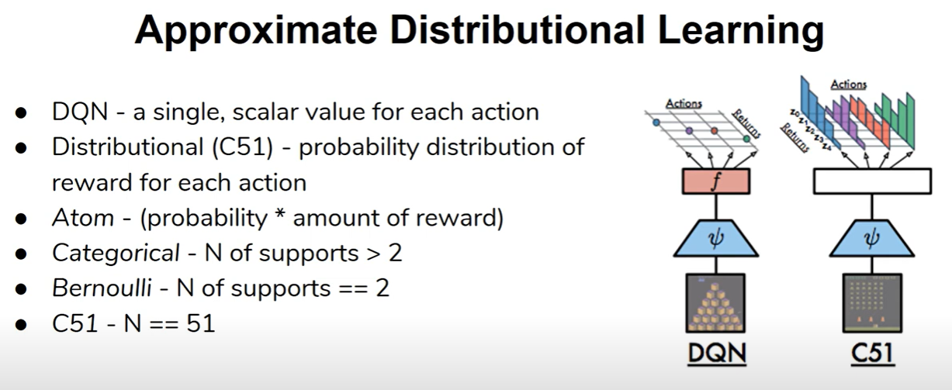
Distributional RL
Preamble
Distributional Bellman Operators
C51 Algorithm
Evaluation and Results
Summary
Notes:
Explain what is Categorical
What is in x - reward and y axis – probability of getting the reward
Aim of DRL- approximate Value distribution
What is Categorical 51 bins . -10 to 10
Compare this C 51 with other algorithms

Slide 21
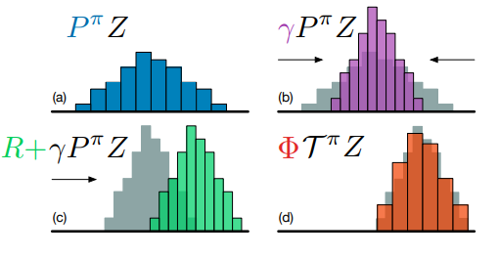
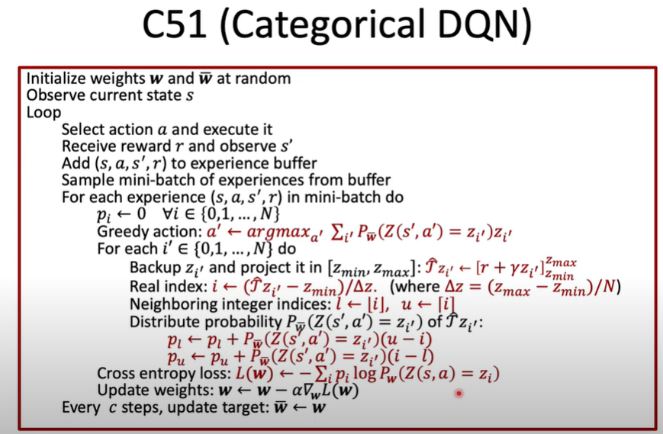
Distributional RL
Preamble
Distributional Bellman Operators
C51 Algorithm
Evaluation and Results
Summary
Notes:
The categorical DQN is a variant of DQN algorithm
Return the distirubition over the return values .
Parameters to get the distribution:
Z min and Z max – The interval of the distribution
Discretized into N – grid points with a space of delta z between them from Z min to Z max
Equally spaced grid points
Here in the algo ,
We start with all the grid points that is N in this case .
The distribution of the network is denoted by pw Z (s’ , a’) denotes that this network is going to give us the probability for the specific grid point Zi
Then compute updates for them by multiplying them with gamma and adding the immediate reward
This gives us new return values but these may not be exactly on grid so we interpolate them
The way we do this is tat we find the index of the grid point that is right below so that we are going to call this index “L” the one that is right above as “U”
So with these gid points we can take prob of out grid point we are currently working on and distribute the prob between l and u . With this we end up with bunch if target values p(i)
With this we can minimize the cross entropy to train the network

Slide 22
Distributional RL
Preamble
Distributional Bellman Operators
C51 Algorithm
Evaluation and Results
Summary
Atari-2600 Benchmark of C51
57 Atari 2600 games - 5 training games , 52 testing games
Low number of actions
State are processed by
a) removing color
b) Cropping
c) Converted into an array if number
Environment is stochastic
a) Agent has a 25% chance to be ignored for its chosen action
Environment variables
a) Score
C51 – SOTA results
Notes:
Benchmark Setup:
The benchmark consists of 57 Atari 2600 games, out of which 5 games are used for training the C51 algorithm, and the remaining 52 games are used for testing.
The games in the benchmark have a low number of actions, which means the agent has a limited set of actions to choose from in each game state.
State Processing:
The state preprocessing involves several steps:
Removing color: The color information is removed from the game frames, likely to reduce the complexity of the state representation.
Cropping: The game frames are cropped to focus on the relevant gameplay area, ignoring unnecessary background information.
Conversion to an array of numbers: The processed frames are converted into numerical arrays, which serve as the input to the reinforcement learning algorithm.
Stochastic Environment:
The Atari 2600 environment is stochastic, meaning that the outcome of actions taken by the agent is not deterministic. Instead, there is some randomness in the environment's response to the agent's actions.
Specifically mentioned is a 25% chance for the agent to ignore the chosen action, adding an element of unpredictability to the environment.
Environment Variables:
The primary environment variable mentioned is the score, which likely represents the agent's performance or progress in the game. The agent's objective is to maximize the score by learning an effective policy.
C51 Algorithm:
C51 stands for Categorical 51, which is a variant of the deep reinforcement learning algorithm known as the Categorical Distributional Reinforcement Learning (CDRL) algorithm.
It's mentioned that C51 achieved state-of-the-art results on the Atari-2600 benchmark, indicating its effectiveness in learning to play a wide range of Atari games.

Slide 23
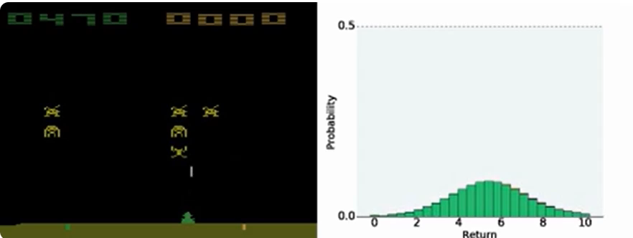
Distributional RL
Preamble
Distributional Bellman Operators
C51 Algorithm
Evaluation and Results
Summary
Notes:
The video shows a distributional agent (C51) during training on the Atari 2600 game Space Invaders. The value distribution for each possible action is shown in a different color on the right.

Slide 24
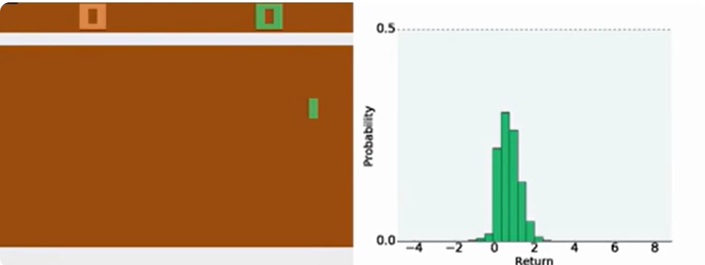
Distributional RL
Preamble
Distributional Bellman Operators
C51 Algorithm
Evaluation and Results
Summary
Notes:
The video shows a distributional agent (C51) during training on the Atari 2600 game Pong. The value distribution for each possible action is shown in a different color on the right.

Slide 25
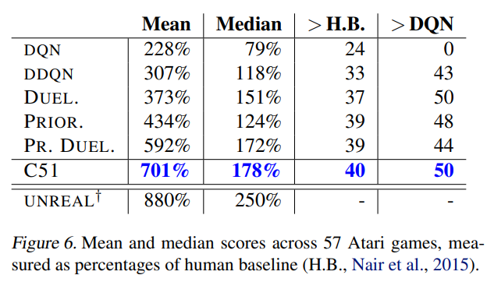
Distributional RL
Preamble
Distributional Bellman Operators
C51 Algorithm
Evaluation and Results
Summary
Notes:
Double Deep Q-Network DDQN
Deep Q-Network

Slide 26
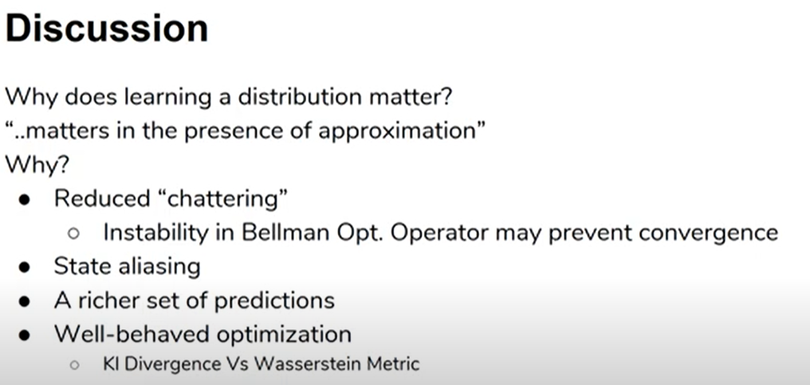
Distributional RL
Preamble
Distributional Bellman Operators
C51 Algorithm
Evaluation and Results
Summary
Notes:
educed Chattering: The distributional approach helps mitigate instability in the Bellman optimality operator, which could lead to what is referred to as "chattering" in the policy convergence process. By effectively averaging different distributions, similar to conservative policy iteration, the algorithm is able to integrate chattering into the approximate solution.
State Aliasing: State aliasing, where different states lead to similar outcomes, can introduce stochasticity even in deterministic environments. By explicitly modeling resulting distributions, the algorithm provides a more stable learning target, addressing issues such as reward timing unpredictability in certain environments like PONG.
Richer Set of Predictions: The distributional approach provides a rich set of auxiliary predictions, specifically the probability that the return will take on a particular value. These predictions are tightly coupled with the agent's performance, offering a more comprehensive learning framework.
Well-Behaved Optimization: Minimizing the Kullback-Leibler divergence between categorical distributions is relatively straightforward and may explain some of the empirical performance observed. Additionally, closer minimization of the Wasserstein metric is suggested to potentially yield even better results.

Slide 27
Distributional RL
Preamble
Distributional Bellman Operators
C51 Algorithm
Evaluation and Results
Summary
Summary
Traditional Value Maximization ( Bellman operators )
Distributional Perspective
Distributional Bellman Equation
Historical Context ( Risk sensitivity , theoretical analysis )
Contraction Properties
Instability in Control Setting
Benefits of Distributional Perspective
Practical Illustration
- Arcade Learning Environment in Deep Q-Networks (DQN)

Slide 28
Thank You !!!

Slide 29
References:
CSL Seminar - https://www.youtube.com/watch?v=IAaUXszVT_A
CS885 Module 5: Distributional RL- https://www.youtube.com/watch?v=r-Yk6-jagDU
A Distributional Perspective on Reinforcement Learning - Marc Bellemare - https://www.youtube.com/watch?v=ba_l8IKoMvU
https://mitpress.mit.edu/9780262048019/distributional-reinforcement-learning/
https://vitalab.github.io/article/2021/02/12/C51.html

Slide 30
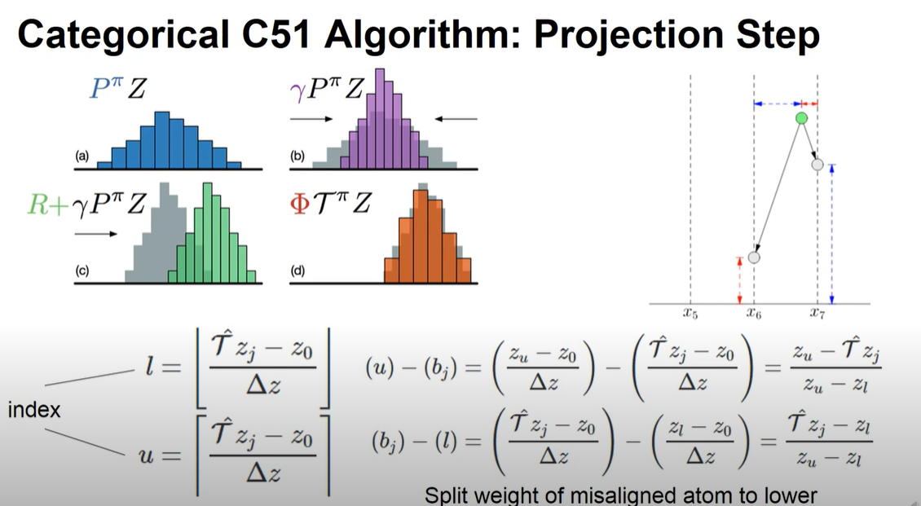
Source

